Slide 1
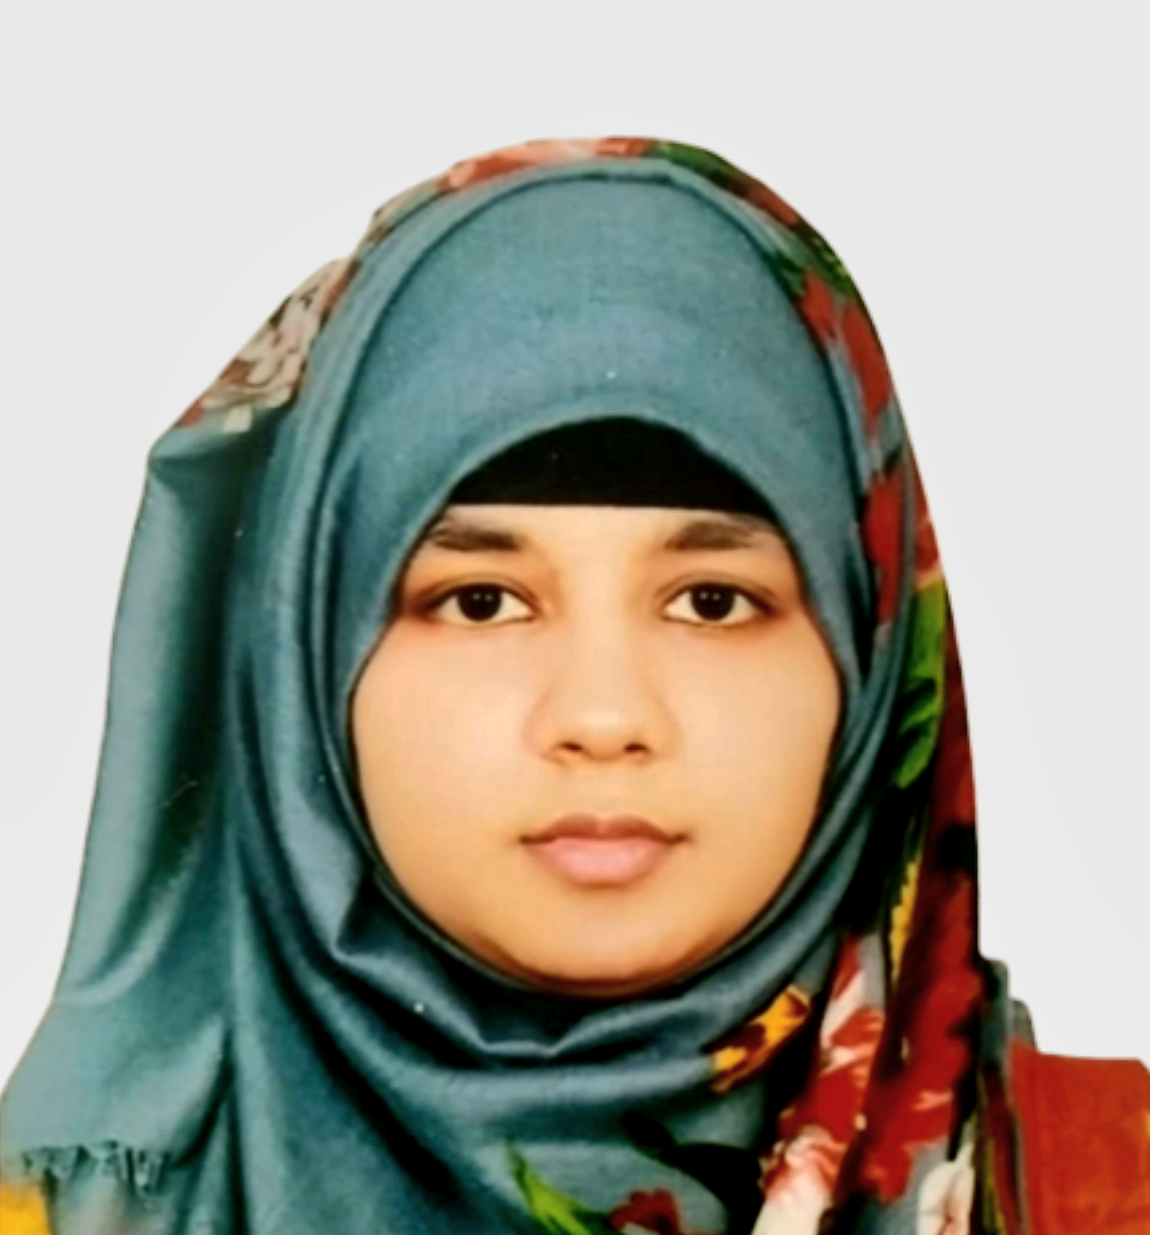
PROFILE
I am a hardworking and ambitious individual with a great passion for the Accounting. I am currently in my second year of studying BBA on Accounting at Independent University, Bangladesh. I have excellent communication skills, enabling me to effectively communicate with a wide range of people. I am seeing a part-time position in the industry in which I can put into practice my knowledge and experience, ultimately benefiting the operations of the organisation that I work for.
TAZRINA AKTER SHUBRA
+8801409-213022
smtazrinashubra@gmail.com
Road-1, Sector-10
Uttara, Dhaka-1230

Slide 2
EXPERIENCE
ACCOUNTANT
Snigdho Fashion House | Dhaka, Bangladesh
January 2021 – March 2022
As an accountant I helped to make financial decisions by collecting, tacking and correcting the company’s finances.
Prepared quarterly tax returns and reviewed submitted documentation with auditors.
Accurately performed daily cash functions, including A/P and A/R tracking, budgeting, payroll transactions, expense management and various reconciliations.

Slide 3
ACADEMIC BACKGROUND
Bachelor of Business Administration
Independent University, Bangladesh (IUB)
January 2022 – Present
HSC on Business Studies
Milestone College
July 2018 – September 2020
SSC on Business Studies
Milestone College
January 2016 – April 2018

Slide 4
SKILLS
Microsoft Word, Powerpoint, Excel
Decision Making
Teamwork and Collaboration
Goal and Conversion Tracking
Written and Verbal Communication

Slide 5
HOBBIES
Art and Drawing
Gardening
Collecting Stones

